Slide 1

Introduction to Tensorflow and the Google Cloud Platform
Randall Fernando

Slide 2
Purpose of today
Understand basics of Machine Learning
How to run Tensorflow using DataLab
Please go to https://github.com/rfern/Tensorflow_DataLab_Tutorial to clone or download the instructions.

Slide 3
About myself
Software Engineer with background in IT/Psychology
Won various awards for using Data
Received Tensorflow and Google Cloud Platform training…
However I am not an expert…

Slide 4
What is Tensorflow?
Tensorflow- Google’s Open Source Machine Learning Library.
Datalab- Interactive tool (Modified version ofJupyter notebook).
BigQuery – Powered by Dremel

Slide 5
What is Machine Learning?
Machine Learning vs Traditional Rule Based Approach
Rule based Approach – You make the rules
Machine Learning- Self Adjusting Algorithm
Why use Machine Learning?
Model automatically adapts to new data (eg. obesity-> wealth)
Find patterns in data that may not be easily seen using traditional modelling.

Slide 6
What is Machine Learning?
Supervised Learning
Used to predict outcome/label based on prior input.
Uses historical data labelled/outcome prior to analysis.
Unsupervised Learning
Used for clustering in groups.
Data where label is not known.
Reinforcement Learning
Used to reinforce actions based on reward
Supervised Learning splits historical data into;
Training Data: Where outcome is known to model. Used to build the model.
Test Data: Where outcome not known to model. Used to check the accuracy of the model + prevent overfitting

Slide 7
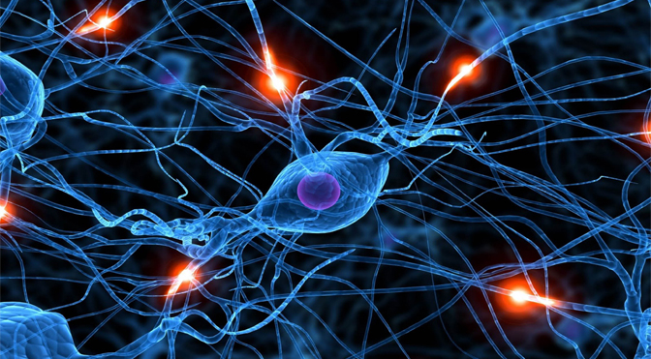
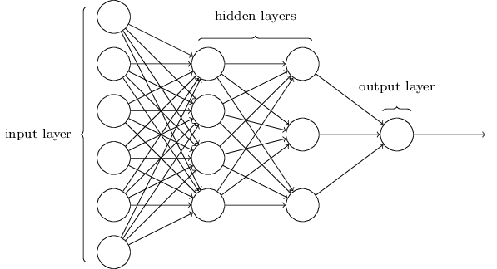
Neural Networks
Neural Network- Prediction Algorithm loosely based on Neurons
Different types of NN
Inputs- Predictors (eg. income, hours of exercise, hours of sleep etc)
Hidden Layer – Learning rules applied to predict output based on input (Neurons, Weights & Activation Function)
Output- Outcome (eg. Obesity)

Slide 8
What is the Hidden Layer?
Weights: Used to increase/decrease influence of input variables
Neurons: Combination of weights and inputs which are then treated with a signal function to determine a predicted outcome
Underlying Methodology: To minimize error in predictions NN uses

Slide 9
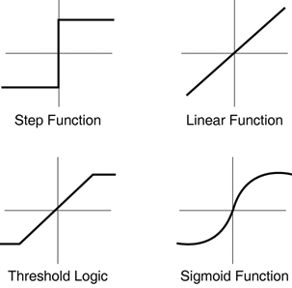
What is a signal function?
Signal Function: Function which determines the Threshold for determining if the predicted outcome is activated or not.
Different Signal Functions (eg. Sigmoid)

Slide 10
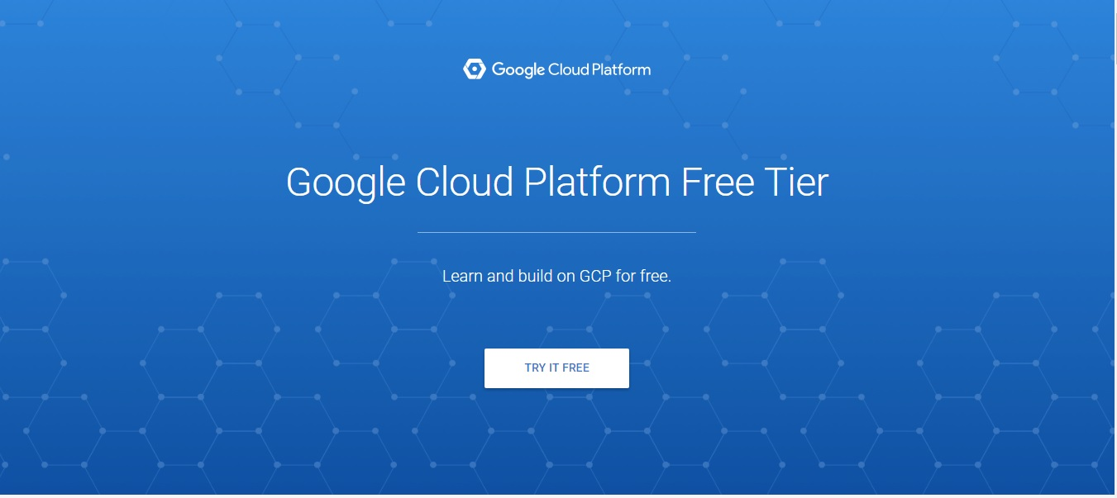
Workshop – Getting free credit
Step 1: Go to https://cloud.google.com/free/ and follow the prompts to get $300 free credit and a 12 month trial to the Google Cloud platform/

Slide 11
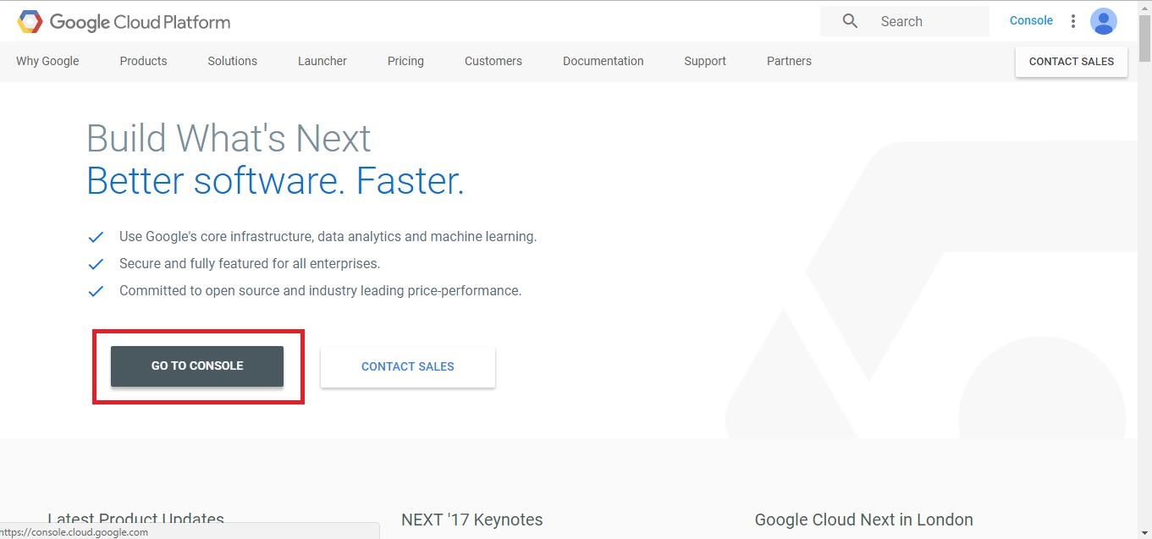
Workshop – Setting up
Step 2: Go to https://cloud.google.com/ and click on ‘go to console’

Slide 12
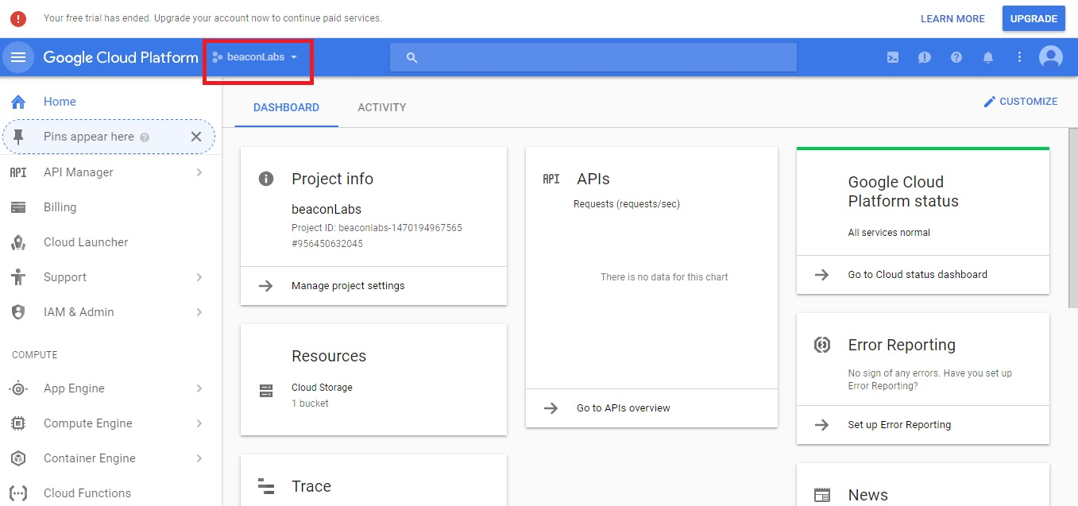
Workshop- Creating a new project
Step 3: Create a new project by clicking the new project by clicking here

Slide 13
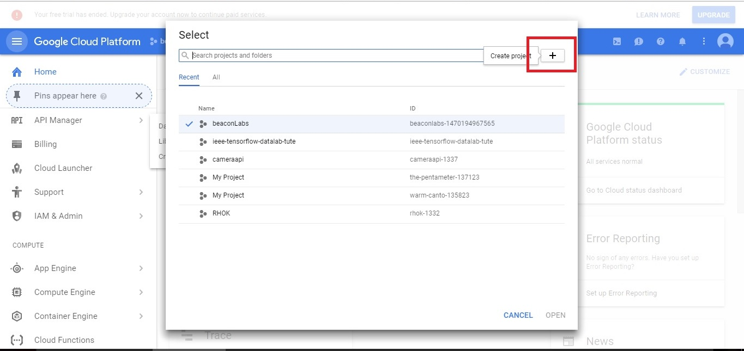
Workshop- Creating a new project
Step 4: Create a new project by clicking the new project by clicking here and giving it a name

Slide 14
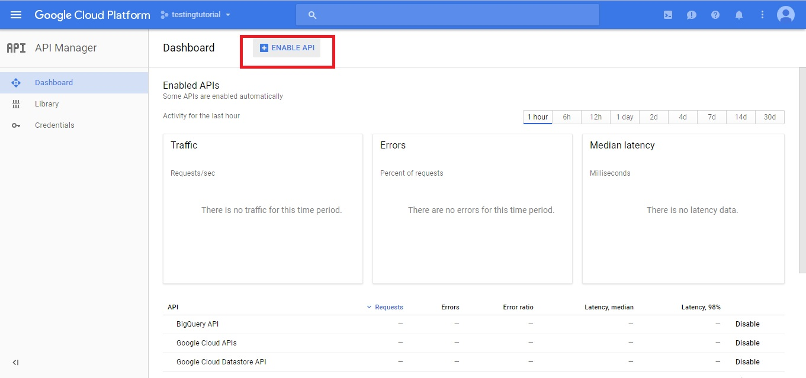
Workshop Enable Google Cloud APIs
Step 5: Go to https://console.cloud.google.com/apis/ to enable the Google Compute Engine API, Google Cloud APIs and the BigQuery API.

Slide 15
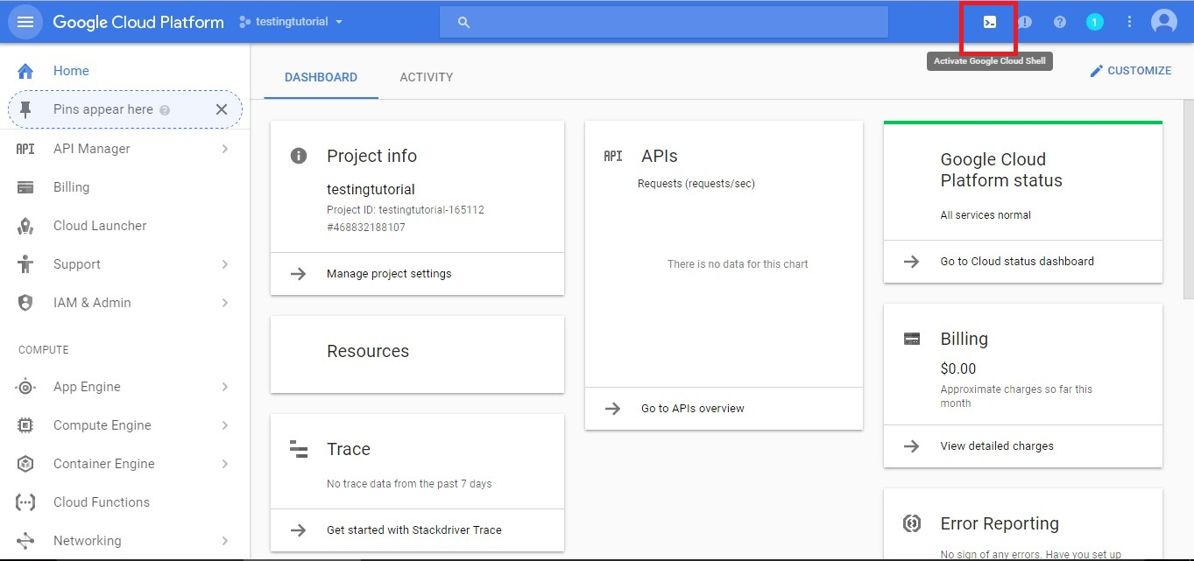
Workshop: Accessing the Cloud Shell
Step 6: Activate the cloud shell by pressing here. This may take a few minutes to create the cloud shell.

Slide 16
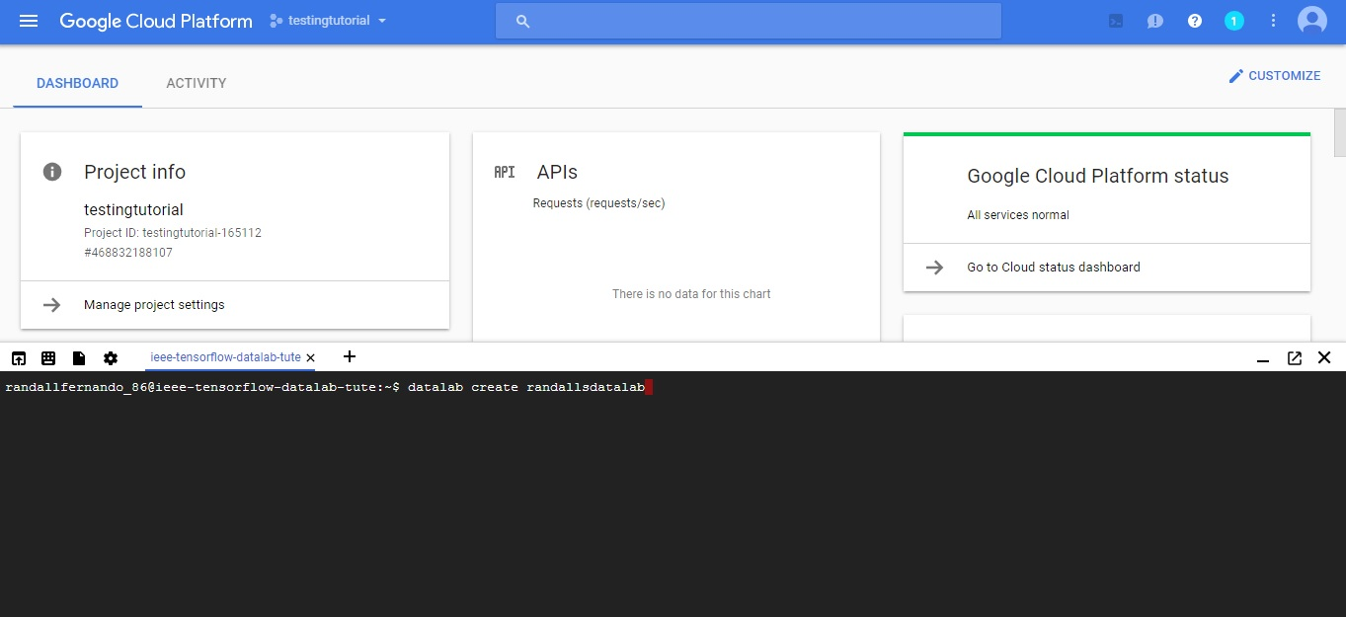
Workshop: Creating a DataLab
Step 7: Within the cloud shell type in;
datalab create <insert whatever lowercase name you like>
It will prompt you for a region. Type in 1 and press enter
This will create a VM instance of the datalab (it will take a few min)
Type in a secure passphrase that you will remember.

Slide 17
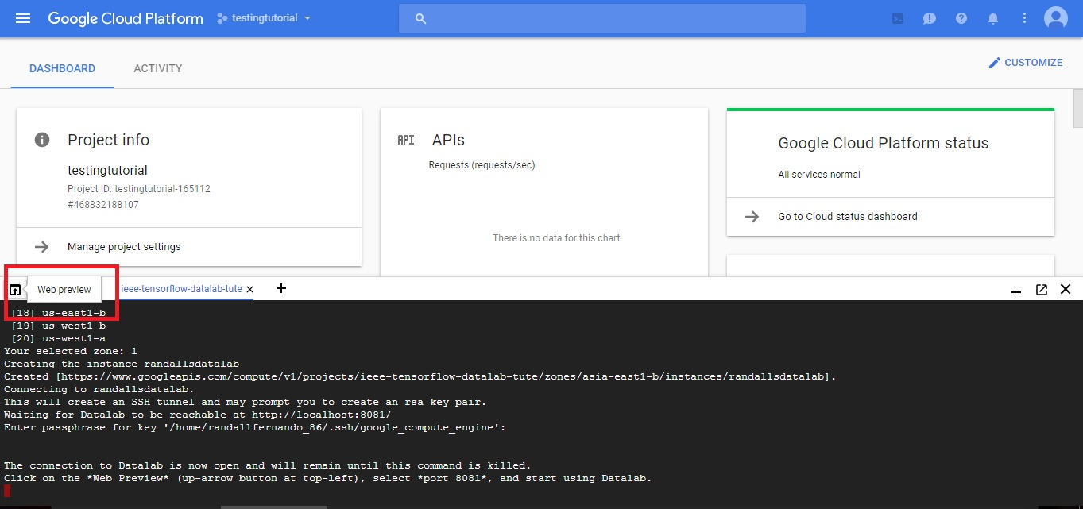
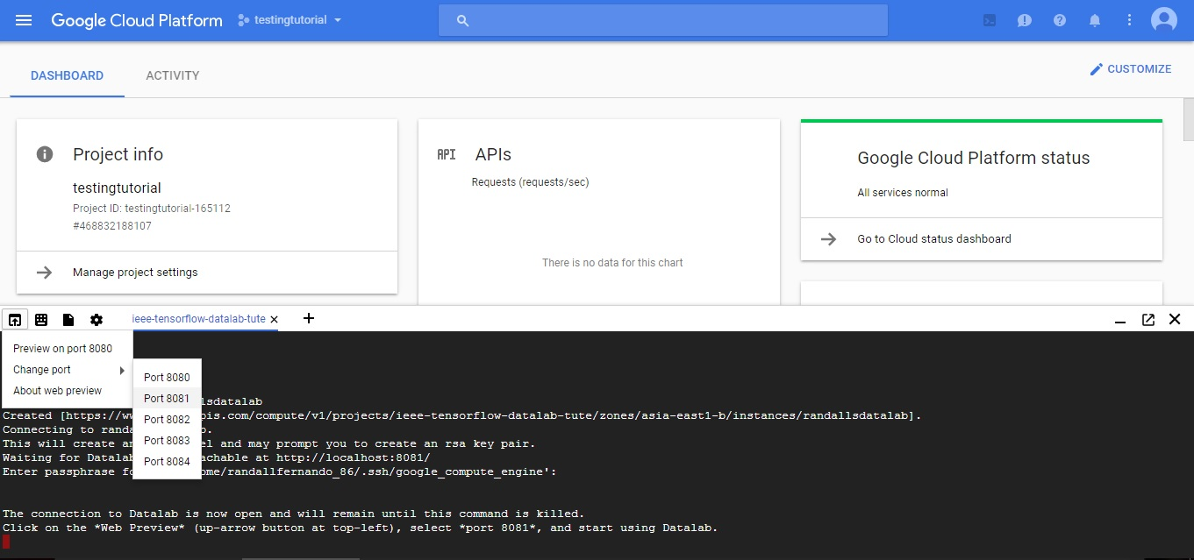
Connecting to the DataLab
Step 8: Click here and change the port to 8081. This will open up the Datalab.

Slide 18
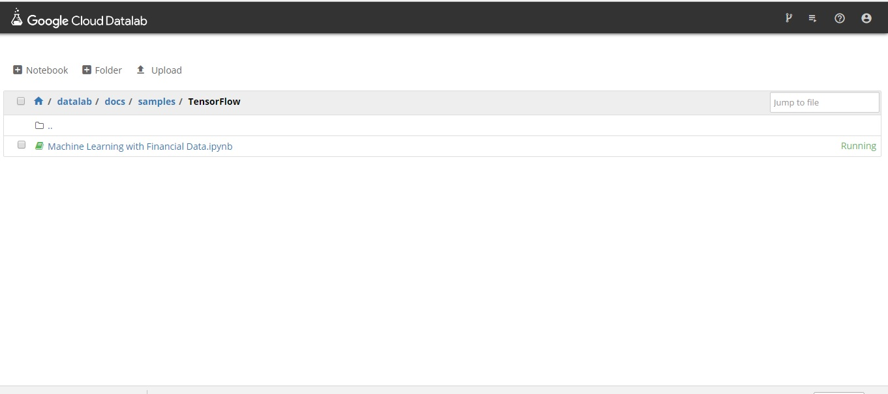
Accessing the DataLab
Step 9: Within the DataLab, go to docs > samples > Tensorflow and Click on ‘Machine Learning with Financial Data.ipynb’ to open up the notebook.

Slide 19
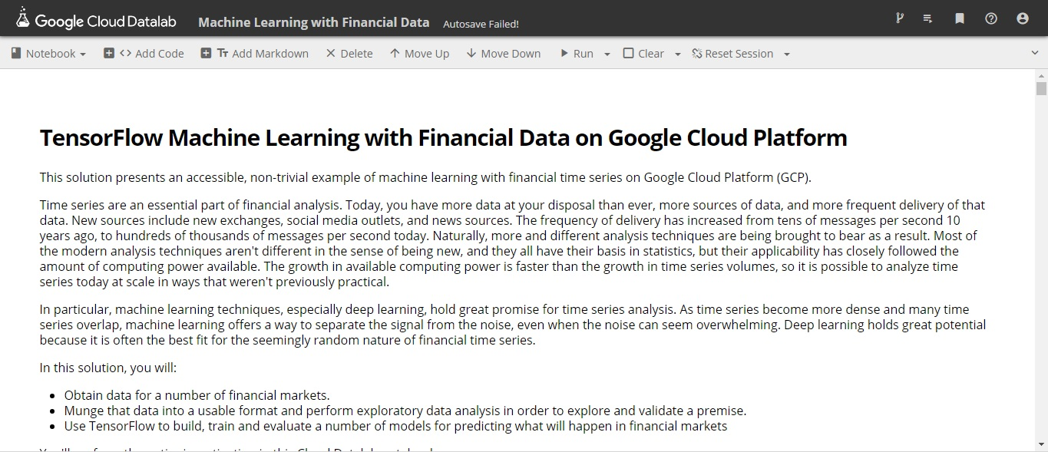
Workshop- Machine Learning
Tutorial examines if the S&P500 Close can be predicted by other Stock Indexes.
S&P500 Index – Stock Index based on companies listed in both NYSE and/or NASDAQ

Slide 20
Workshop
Exploratory Data Analysis – indicates that there are some predictors of S&P Close.
European indices
Asian/Oceanic indices
Use these predictors to determine if we can predict if the S&P Close is higher or lower.

Slide 21
Workshop
Initially use a Simple Neural Networkto determine whether the S&P Close is higher or lower.
80% of Records - Training data to build the model
20% of Records – Test Data to assess accuracy of model
Initial accuracy pretty good (~82%).

Slide 22
Workshop
Using a more complex Neural Network with 2 hidden layers.
Accuracy improved significantly (~88%).

Slide 23
Questions

Slide 24
Thanks!

